Slide 1
Academic Writing
Task2 话题
环境类+ 媒体类+科技类

Slide 2

环境类话题
环境
Notes:
环境问题的核心，在于导致什么问题，原因什么，怎样解决

Slide 3
环境类话题
A
B
经济发展
人类活动
why?
what?
资源短缺
生态破坏
个人意识
公司发展
国家
国际合作
科技发展
C
D
意识
收税
投资科技
法律政策
建立保护区
who?
how?

Slide 4
环境类话题
Some people say that the main environment problem of our time is the loss of particular species of plants and animals. Others say there are more important environment problems. Discuss both these views and give your own opinion. （C14T2W2）

Slide 5
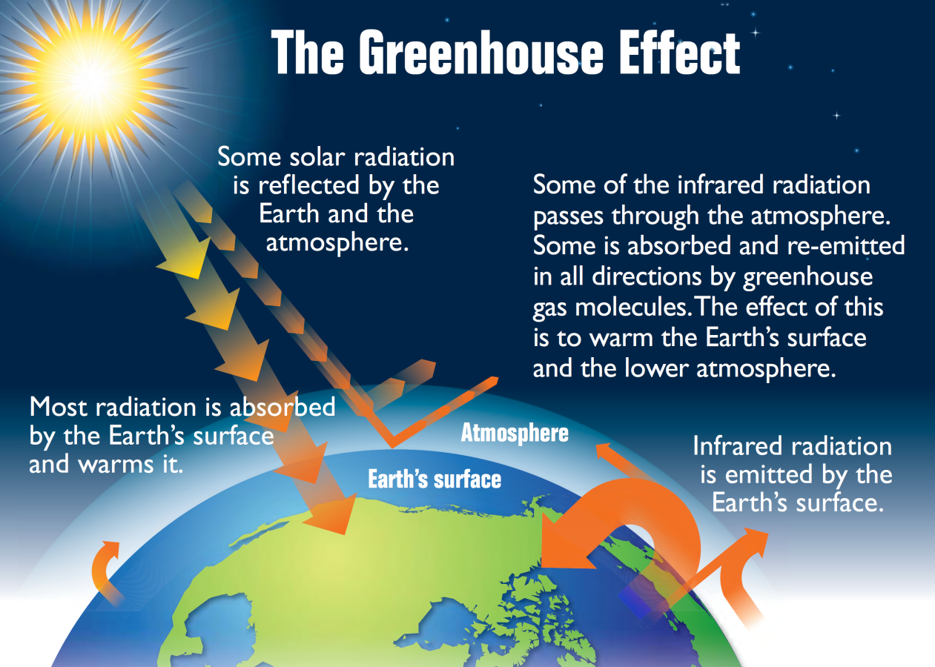
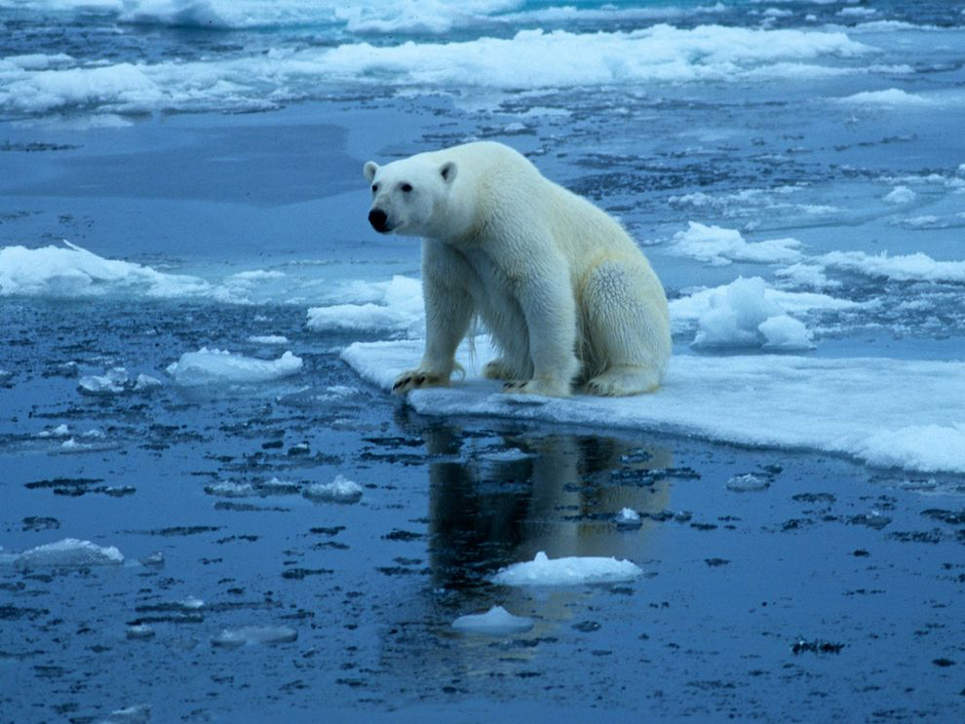
环境类话题
环境问题
global warming: melting glaciers -> sea level rise
Notes:
deteriorate/aggravate/exacerbate

Slide 6
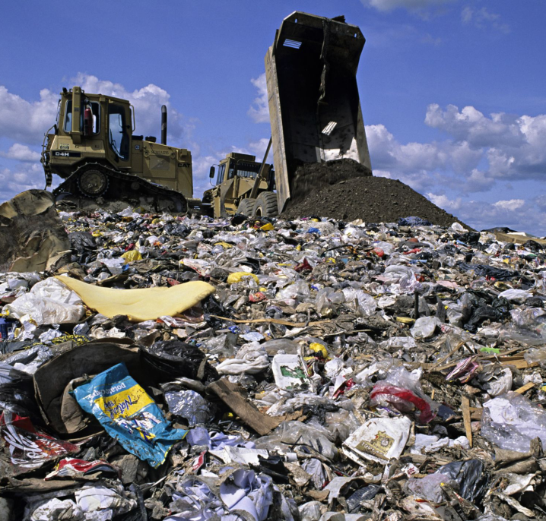
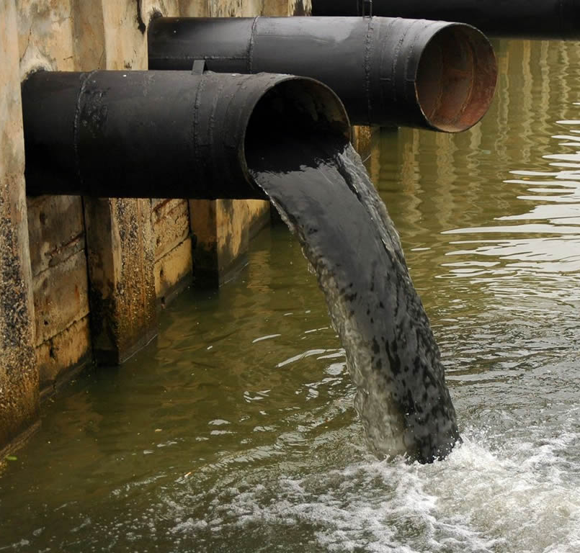
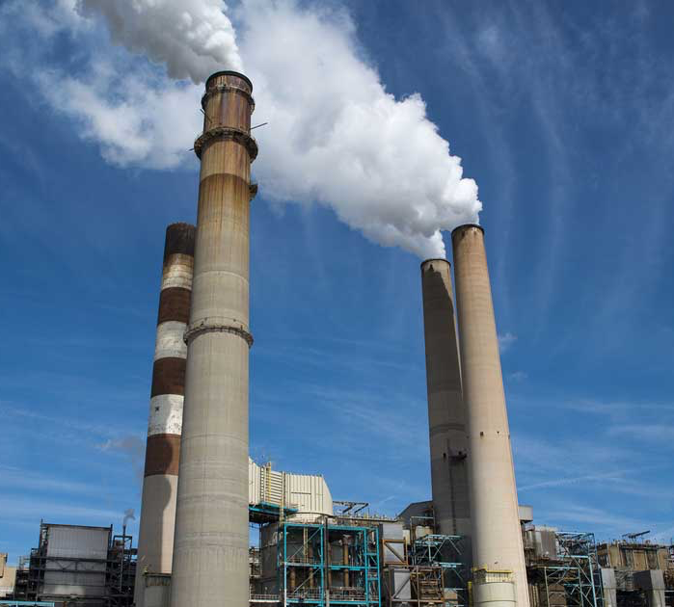
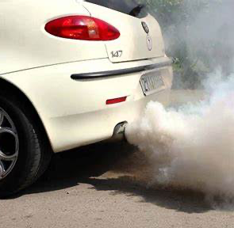
环境类话题
环境问题
increased pollutants：
garbage（discarded plastic waste.）; sewage/effluent; flue/exhaust gas
Notes:
deteriorate/aggravate/exacerbate

Slide 7
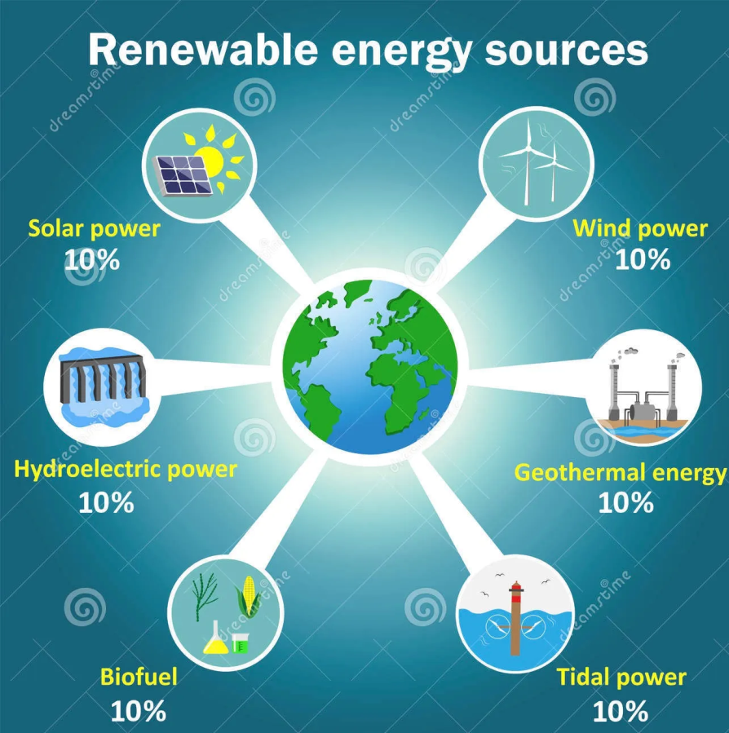

环境类话题
环境问题
natural resources shortage：
lack of alternative/renewable energy
insufficient fresh water
Notes:
deteriorate/aggravate/exacerbate

Slide 8
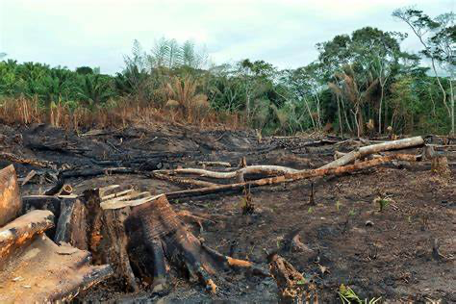
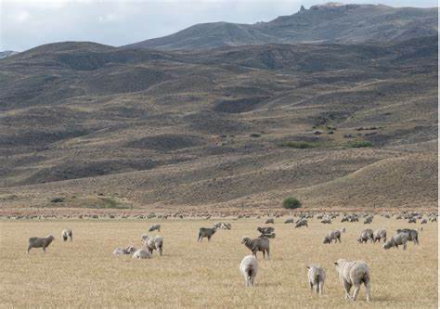
环境类话题
环境问题
food supply problem:
deforestation; overgrazing -> lower fertility
Notes:
deteriorate/aggravate/exacerbate

Slide 9
环境类话题
Some people say that the main environment problem of our time is the loss of particular species of plants and animals. Others say there are more important environment problems. Discuss both these views and give your own opinion. （C14T2W2）
考官范文
首段：
Some people consider that the loss of individual species of plants and animals is the main environmental problem of our time. Attempts to preserve rare or dying species are carried out in zoos or other specialist plant and animal facilities, through breeding programmes, preservation orders and other forms of protection and there was genuine sadness among many when the last surviving white rhino died earlier this year.

Slide 10
环境类话题
Some people say that the main environment problem of our time is the loss of particular species of plants and animals. Others say there are more important environment problems. Discuss both these views and give your own opinion. （C14T2W2）
考官范文
主体段1：
Survival of the fittest is nature's way of ruthlessly allowing weaker specimens to die out, although mankind has also contributed to falling animal numbers through hunting and poaching. However, whether saving individual species should be the main focus of environmental protection is debatable. Climate change and excessive use of plastic are just two other major problems that deserve our attention.

Slide 11
环境类话题
Some people say that the main environment problem of our time is the loss of particular species of plants and animals. Others say there are more important environment problems. Discuss both these views and give your own opinion. （C14T2W2）
考官范文
主体段2：
The evidenee of climate change is there for us all to see: rising sea levels and associated flooding with the loss of homes at low land levels are becoming more frequent. Many countries and island communities are now calling for urgent action to delay, halt or even reverse the process, although if we believe the experts, reversal is impossible. Habitable areas are gradually shrinking, often for some of the poorest groups of people, but there seems to be little obvious action taking place. If the major contributors to climate change will not support the reduction of greenhouse gases, there is little hope for the future.

Slide 12
环境类话题
Some people say that the main environment problem of our time is the loss of particular species of plants and animals. Others say there are more important environment problems. Discuss both these views and give your own opinion. （C14T2W2）
考官范文
主体段3：
Naturalists have also begun to expose the serious problems arising from discarded plastic waste. Birds and animals can die gruesome deaths through being trapped or caught up in plastic bags or ropes, while the long process required for these plastics to decay means that they remain a threat for many years to come. Worse, there is now beginning to be evidenee of sea creatures ingesting smaller globules of disintegrating plastic, which harms them and all the other creatures in their particular
food chain.

Slide 13
环境类话题
Some people say that the main environment problem of our time is the loss of particular species of plants and animals. Others say there are more important environment problems. Discuss both these views and give your own opinion. （C14T2W2）
考官范文
结尾段：
The loss of particular species, both flora and fauna, is cause for regret, but I do not agree that they are the most important environmental problems these days. If climate change and damage from plastic continue, there will be less land and less food for everyone, ineluding plants and animals.

Slide 14
环境类话题
导致原因
环境污染
non-biodegradable materials -- packaged and canned food
traffic pollution -- greenhouse/carbon dioxide gas emissions
nuclear accidents -- toxic nuclear wastes
生态破坏(动物相关)
log forests-> destroy wildlife habitats-> reduce biodiversity
illegal wildlife products -> endangered animals become extinct
animal testing: cause suffering to animals(cruel and inhumane)

Slide 15
环境类话题
解决方法
国际合作（global cooperation）的原因：
共享地球资源 share the earth supply
有些环境问题会从regional(地区性的)变成worldwide(全球性的)， unilateral moves are not enough(单方面的努力是不够的)
国际合作的措施：
reach the agreement
set international standards for environmental protection
cover the shortage of the technology and labor force
国际

Slide 16
环境类话题
解决方法
立法: introduce some practical laws and regulations
(e.g. ban the use of plastic bags to tackle “white pollution”)
收税 impose “green taxes” on drivers and airline companies
投资科技 invest in renewable energy from solar, wind or hydro power
提高意识 government campaigns raise public’s green awareness
建立自然保护区 set up natural reserve
国家
Notes:
exploit renewable energy; encourage low carbon lifestyle; avoid using throw-away products;offer subsidies to hybrid car buyers;

Slide 17
环境类话题
解决方法
守法 obey the related environmental regulations
引进设备技术处理污染 import advanced facilities to treat sewage and exhaust discharged from the process of production
使用新能源能源 alternative energy to increase the fuel efficiency
使用高科技环保材料 hi-tech environmentally friendly materials
(e.g. degradable plastic bags可降解塑料袋)
企业

Slide 18
环境类话题
解决方法
提高环保意识 individuals should also try to be greener
使用公共交通，减少私家车出行 take more public transportation rather than drive around in private cars
尽量不适用一次性产品disposable products
选择包装简单的商品choose products with less packaging
多回收利用recycle as much as possible
个人
Notes:
sort the daily garbage; consume less and recycle more;

Slide 19
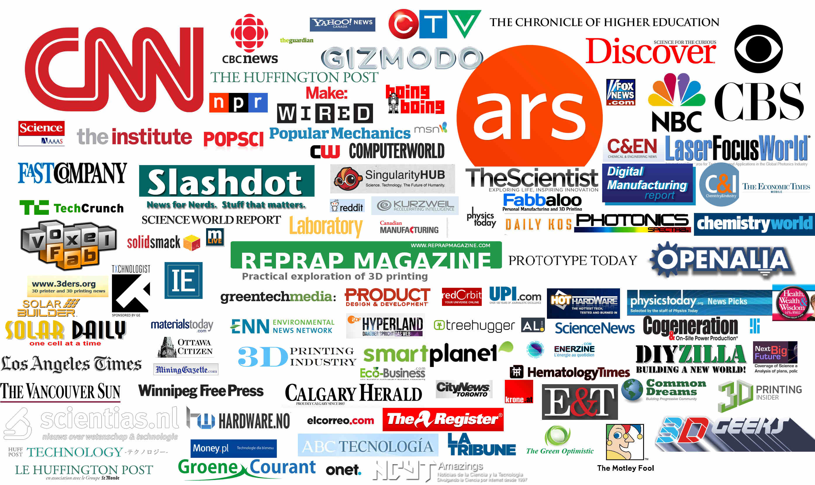
媒体广告类话题
types of media
print media-newspaper, magazines
broadcast media-television, radio
support media - outdoor，transit advertising
internet - website，e-commerce，online ads
Notes:
媒体和广告的作用和暴露出的问题

Slide 20
媒体广告类话题
新闻媒体
News media has become more influential in people's lives. Some people believe it is a negative development. To what extent do you agree or disagree?（20160123）
News media are important in modern society. Why are they so important? Are their influences generally positive or negative?（20120317）

Slide 21

媒体广告类话题
新闻媒体作用
信息性
教育性
娱乐性
Notes:
媒体的教育性：有阅读习惯的人来说获益良多，例如阅读国际新闻，可以培养人的全球化视角，开拓人的眼界，培养人的分析性思维，理性思维，辩证思维
媒体的信息性: 大众获得信息的重要渠道，阅读本国的时事政治，很多消息跟个人有关，例如，很多企业家看新闻联播，投资者通过新闻了解国家政策和市场信息，
媒体的娱乐性：给大家提供消遣娱乐，看别人的故事，了解不同的人生

Slide 22
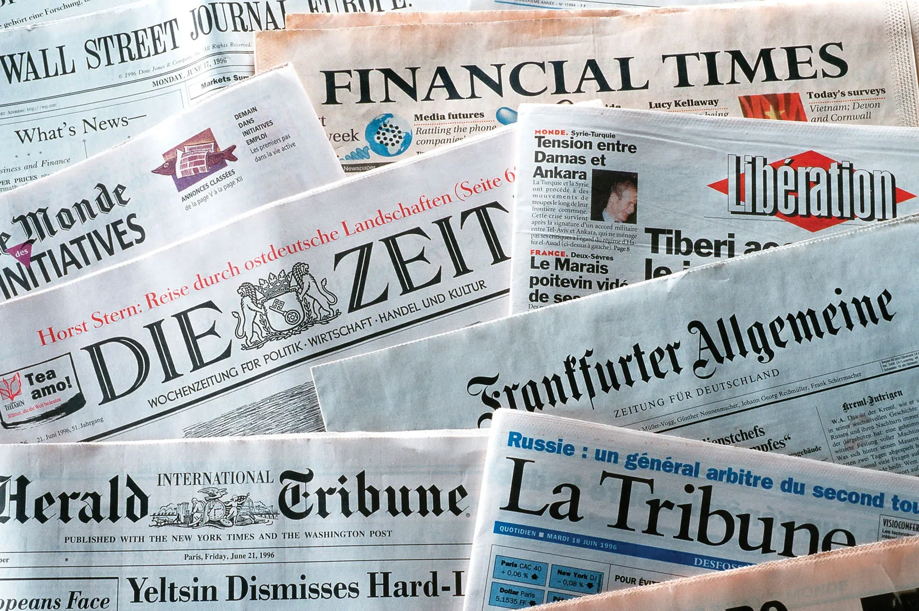
媒体广告类话题
新闻媒体作用
信息性
disseminate news information
stay up-to-date with the current affairs
be informed about the policy
financial news allow entrepreneurs to stay informed about developments in business
when natural disasters happen, news media can encourage people to take immediate actions
Notes:
媒体的教育性：有阅读习惯的人来说获益良多，例如阅读国际新闻，可以培养人的全球化视角，开拓人的眼界，培养人的分析性思维，理性思维，辩证思维
媒体的信息性: 大众获得信息的重要渠道，阅读本国的时事政治，很多消息跟个人有关，例如，很多企业家看新闻联播，投资者通过新闻了解国家政策和市场信息，
媒体的娱乐性：给大家提供消遣娱乐，看别人的故事，了解不同的人生，

Slide 23
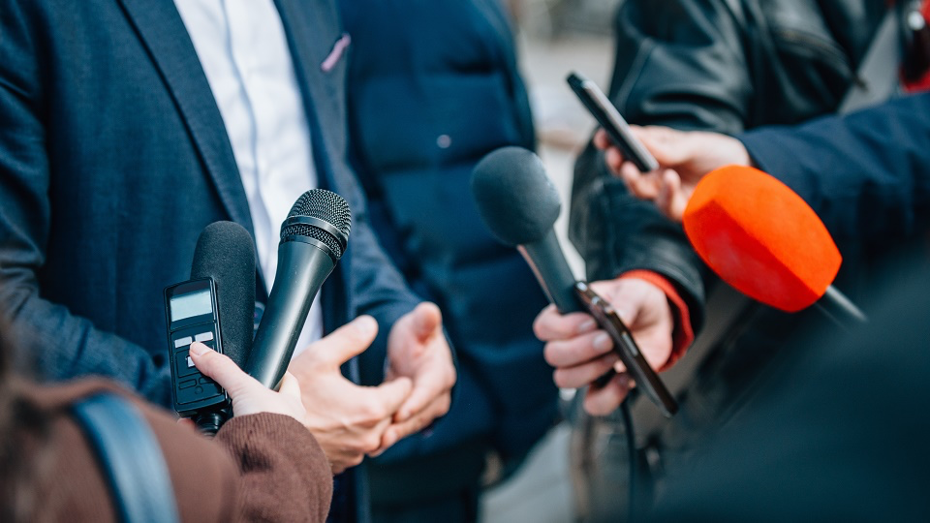
媒体广告类话题
新闻媒体作用
教育性
disclose social problems
deter the general public
monitor and push the government to tackle problems
Notes:
媒体的教育性：有阅读习惯的人来说获益良多，例如阅读国际新闻，可以培养人的全球化视角，开拓人的眼界，培养人的分析性思维，理性思维，辩证思维
媒体的信息性: 大众获得信息的重要渠道，阅读本国的时事政治，很多消息跟个人有关，例如，很多企业家看新闻联播，投资者通过新闻了解国家政策和市场信息，
媒体的娱乐性：给大家提供消遣娱乐，看别人的故事，了解不同的人生，

Slide 24
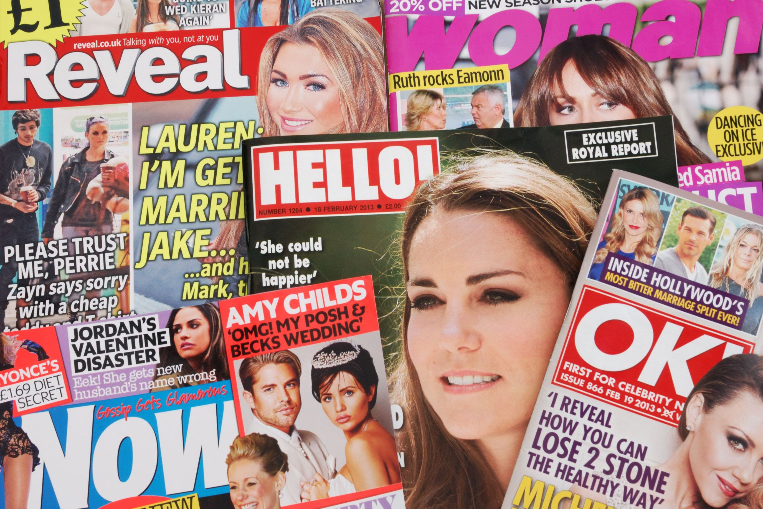
媒体广告类话题
新闻媒体作用
娱乐性
provide entertainment
a good way to reduce stress
Notes:
媒体的教育性：有阅读习惯的人来说获益良多，例如阅读国际新闻，可以培养人的全球化视角，开拓人的眼界，培养人的分析性思维，理性思维，辩证思维
媒体的信息性: 大众获得信息的重要渠道，阅读本国的时事政治，很多消息跟个人有关，例如，很多企业家看新闻联播，投资者通过新闻了解国家政策和市场信息，
媒体的娱乐性：给大家提供消遣娱乐，看别人的故事，了解不同的人生，

Slide 25
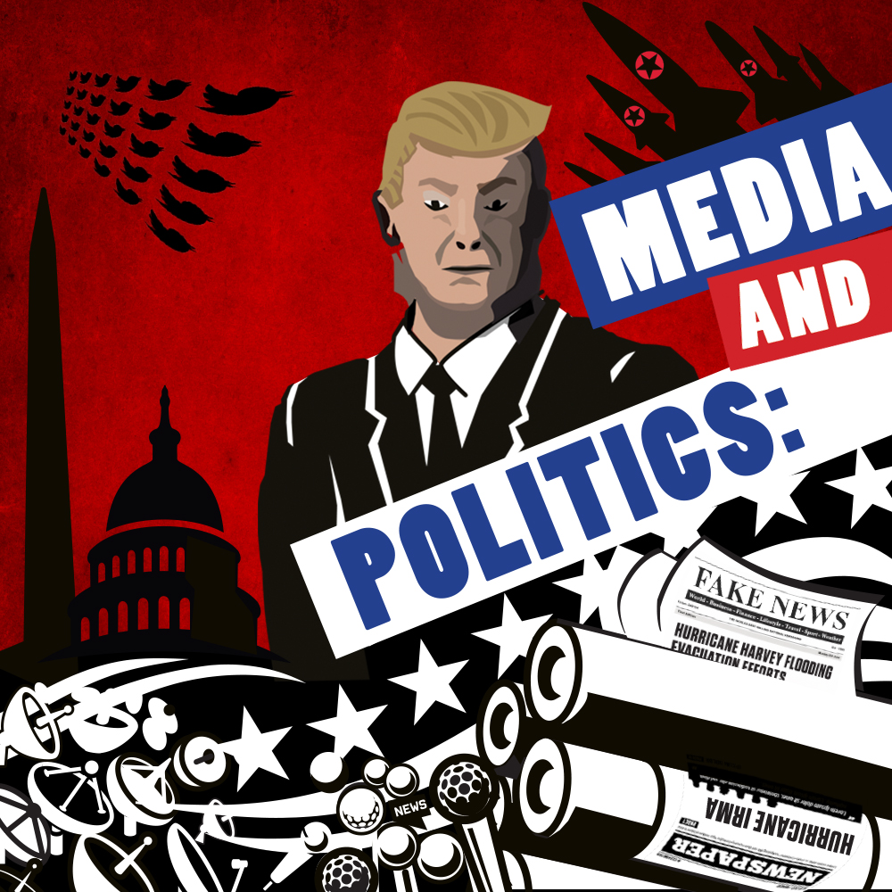

媒体广告类话题
新闻媒体问题
tabloid(小报): irrelevant to our daily lives
sensationalize to boost click-through rate for commercial advantage, including gossip(八卦), rumors(流言), media hype(炒作)
controlled by the state for propaganda purposes
Notes:
媒体和广告的作用和暴露出的问题

Slide 26
媒体广告类话题
广告
People nowadays are surrounded by all kinds of advertising. Some people believe that advertising has a negative effect on people's lives. To what extent do you agree or disagree?（20151205）
Nowadays a large amount of advertising aiming at children should be banned because of the negative effects. To what extent do you agree or disagree?（20110915, 20071117）
Nowadays, an increasing number of advertisements are being directed at children, which persuade children to buy food, toys or other products. Parents believe it put great pressure on children. However, some advertisers claim there are still useful information in advertisement. Discuss both these views and give your own opinion. (2016-07-09 /2006-09-02)

Slide 27
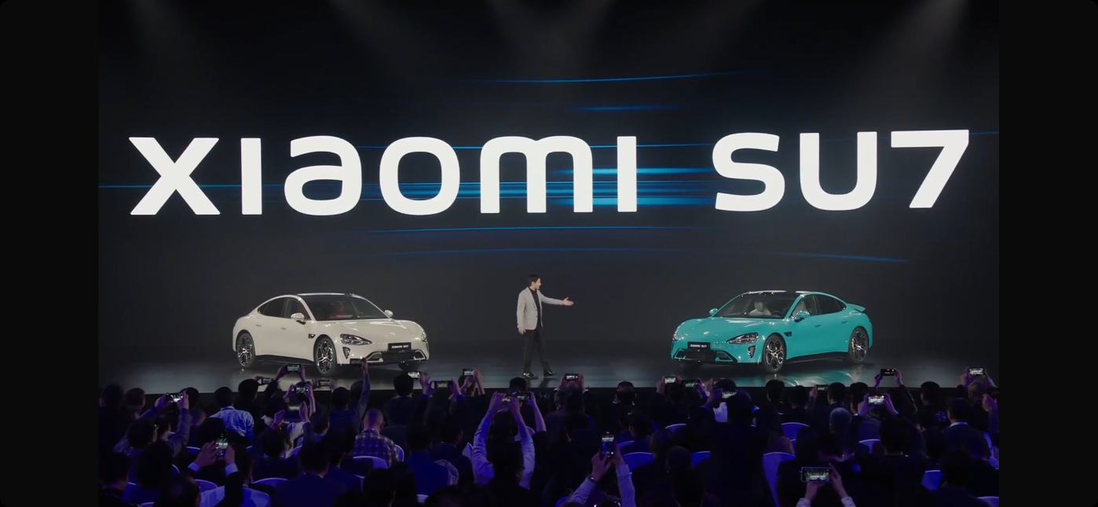
媒体广告类话题
广告作用
bridge the gap between consumers and manufacturers
inform consumers of new products
help consumers find suitable products

Slide 28
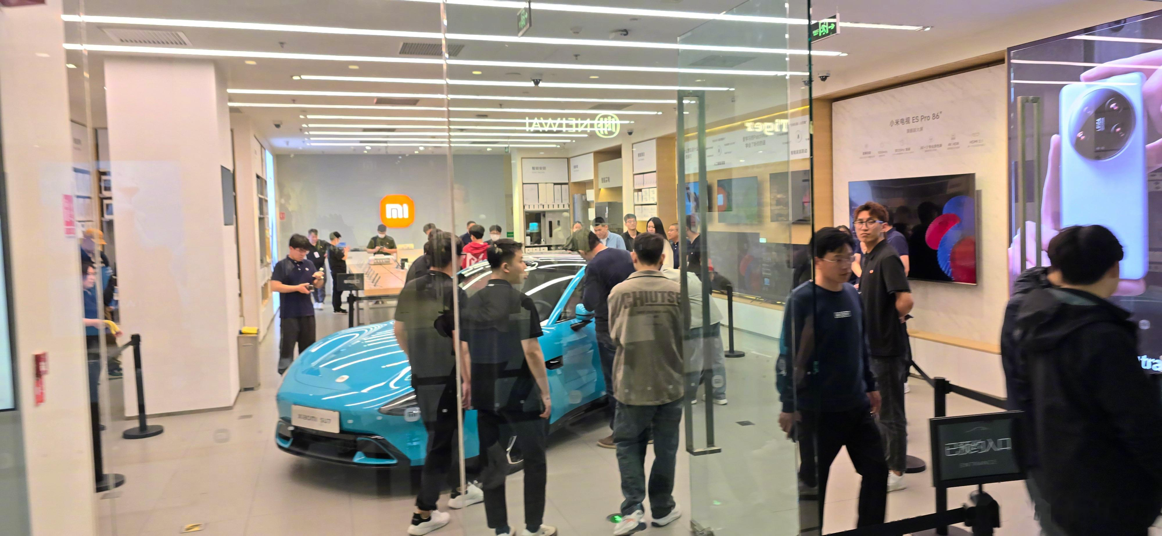
媒体广告类话题
广告作用
boost sales
promote economic development
provide employment opportunities

Slide 29
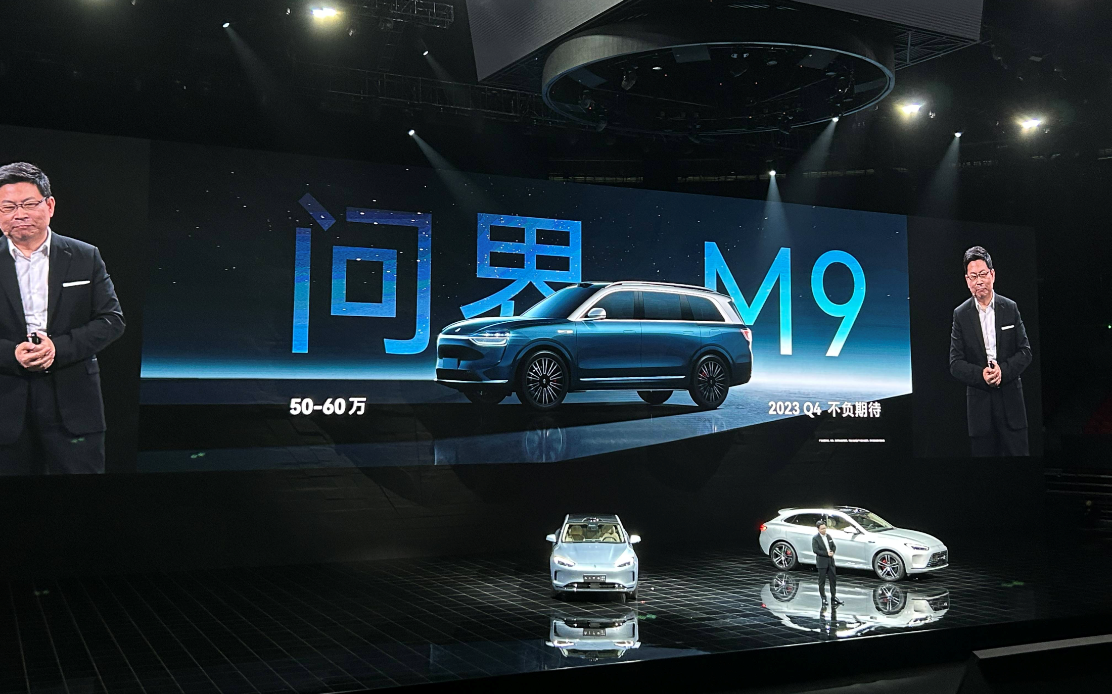
媒体广告类话题
广告作用
encourage competition in quality
product innovation

Slide 30
媒体广告类话题
广告作用
non-profitable advertisements/public service announcement
(公益广告)
raise public awareness of major issues in the world
promote the equity and general wellbeing of our society

Slide 31

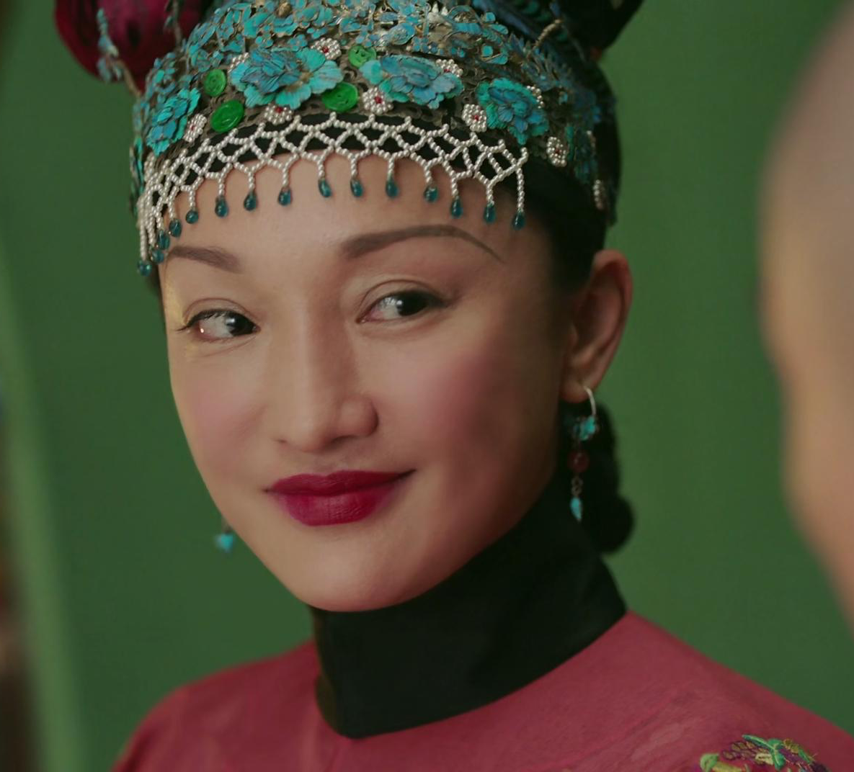
媒体广告类话题
广告问题
hardly provide full disclosure of product characteristics
make exaggerated claims about products
exploit consumers’ lack of experience and knowledge
manipulate them to purchase what they do not really need

Slide 32
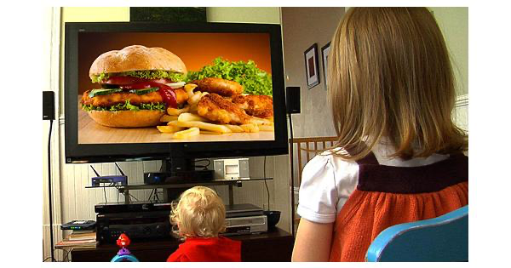
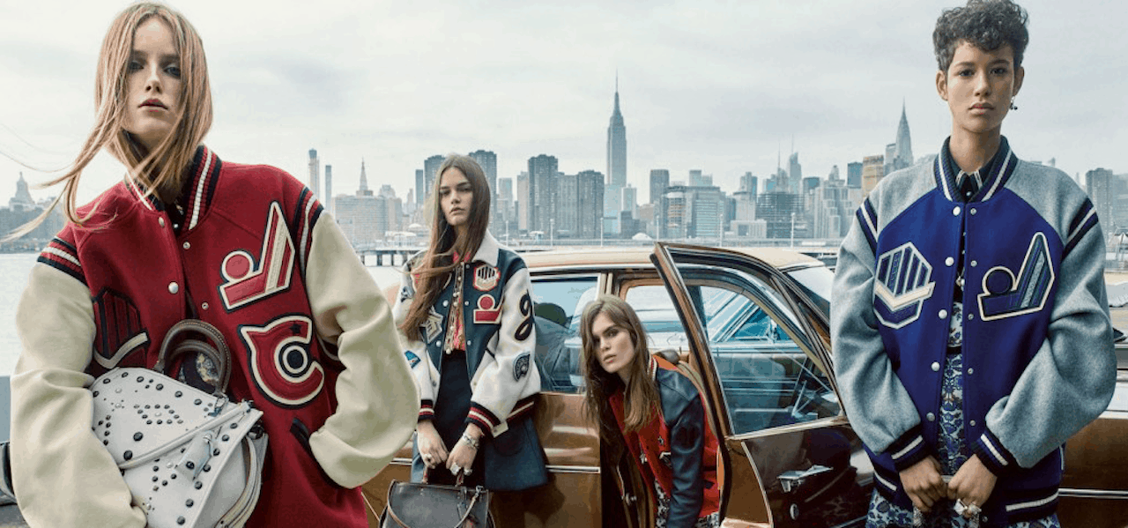
媒体广告类话题
儿童广告问题
children are too gullible to distinguish between right and wrong
unhealthy snacks, food and drinks give rise to a staggering increase in obesity rates
overwhelmed by eye-catching pictures-> ask their parents for desired products regardless of price and function-> bandwagon effect -> detrimental to psychological health.
consumerism(消费主义) materialism(物质主义) vanity(虚荣)

Slide 33
媒体广告类话题
Nowadays a large amount of advertising aiming at children should be banned because of the negative effects. To what extent do you agree or disagree?（20110915, 20071117）
同意ban
限制和规范
不同意ban
ban/不ban
commercials
non-profitable ads
2种辩证统一
限制规范commercials
倡导
non-profitable ads
教育意义：
尊老爱幼，正确的价值观和道德观
环境保护
1. Direction心理
2. Direction 身体
3. 内容 错误的广告
2. 法律的普及

Slide 34
媒体广告类话题
Nowadays a large amount of advertising aimed at children should be banned because of its negative effects. To what extent do you agree or disagree?20160220（9分达人3）
首段：
Advertisements aimed at children can be seen everywhere these days: TV, the Internet, newspapers and magazines, to name only a few. Many people believe they should be banned because of their negative influence on children. While these advertisements do have some benefits, they are informative at least, I am quite convinced that they are more harmful than beneficial to children.

Slide 35
媒体广告类话题
Nowadays a large amount of advertising aimed at children should be banned because of its negative effects. To what extent do you agree or disagree?20160220（9分达人3）
主体段1：
In the first place, in order to attract children, many advertisers tend to over emphasize the “fun side‘ of their products. More often than not they will promote such products as computer games, dolls, animal parks and so on. I admit these products may be important to children, yet too much of them would distract children from their study. Even when they are advertising learning-aid products, the advertisers often claim their products will make children’s learning process full of fun. This is really bad because it gives children a false impression that they do not have to put serious efforts into their study. In addition, children advertising is not desirable because it often leads children to buy things that they do not really need. That is why many parents complain that their children do not buy anything but those expensive famous brands’ such as Adidas. Nike and similar brands of mass consumption.

Slide 36
媒体广告类话题
Nowadays a large amount of advertising aimed at children should be banned because of its negative effects. To what extent do you agree or disagree?20160220（9分达人3）
主体段2：
At the same time, children advertising is partly responsible for children being kept away from reality. Catering to the psychological needs of children, many advertisements describe the world in highly imaginative and unrealistic manners. For instance, when they want to promote their doll weapons, they will describe the world as a place full of bad guys. A child exposed to such advertising may develop a deep sense of hostility to the world. On the other hand, when they want to sell entertainment park tickets to children, they will describe the world as a place full of love and without any danger at all. A child who has been made to believe this kind of advertising will have a hard time when he/she comes across troubles in real life.

Slide 37
媒体广告类话题
Nowadays a large amount of advertising aimed at children should be banned because of its negative effects. To what extent do you agree or disagree?20160220（9分达人3）
结尾：
To conclude, since most children advertisements are misleading, they are really harmful to children who are not old enough to tell the difference between imagination and reality. Indeed, these advertisements may provide useful information for children, but information.

Slide 38
媒体广告类话题
Some people say that advertising is extremely successful at persuading us to buy things. Other people think that advertising is so common that we no longer pay attention to it. Discuss both these views and give your own opinion.（C15Test3Task2 Sample Answer Band 7）
首段：
Advertisement has always been a crucial part in the world of marketing. Throughout the decade we have seen a significant increase in the number of advertisements, whether it is on the media like television or widespread through social network platforms. The goal of advertisements is to get consumers to buy a targeted product, and while this method has been proven considerably successful, some people view it as too prevalent to catch the consumers' attention anymore.

Slide 39
媒体广告类话题
Some people say that advertising is extremely successful at persuading us to buy things. Other people think that advertising is so common that we no longer pay attention to it. Discuss both these views and give your own opinion.（C15Test3Task2 Sample Answer Band 7）
主体段1：
Advertisements can act as a strong persuasion device to seemingly hypnotize people into buying goods and services. This is so because of the tactics placed in the messages, such as showing people having a good time together when using a particular product, using bandwagon, showing only the upsides of usage, and applying compare and contrast strategies to show the effects of using the product and make if stand out. Even if people do not know it, these messages are repeated several times and soon it may brainwash people to Finally go out and get the product. For instance, if a person is watching television and sees a certain advertisement of a snack many times, the repeated sight of the scrumptious food may result in that person feeling hungry and succumbing to the advertisement at last.

Slide 40
媒体广告类话题
Some people say that advertising is extremely successful at persuading us to buy things. Other people think that advertising is so common that we no longer pay attention to it. Discuss both these views and give your own opinion.（C15Test3Task2 Sample Answer Band 7）
主体段2：
Nevertheless, there is another point of view in which the widespread of advertisements makes it a normal thing. After watching a dozen of advertisements people will see it as a mere everyday routine and cease to pay attention to the message of the advertisement. Some people may even choose to turn off a television channel, for instance, only just to avoid seeing and hearing repetitive advertisements. After a certain frequency, they start to get bored and stop paying attention to ads. Hence, in the end, the main goal of advertisements is not complete since the people whom the messages are sent out to do not receive that message. A real-life example can be seen from advertisements in a particular social media platform, YouTube. In the YouTube marketing, advertisements are place before and in between videos, hoping that the viewers would also be forced to watch the advertisements, too. However, this is not usually the case, since many people would just click "Skip Ad" and continue on.

Slide 41
媒体广告类话题
Some people say that advertising is extremely successful at persuading us to buy things. Other people think that advertising is so common that we no longer pay attention to it. Discuss both these views and give your own opinion.（C15Test3Task2 Sample Answer Band 7）
结尾：
ln conclusion, advertisements can be successful in persuading people to purchase goods and services, or they can be unsuccessful in many was. They are very commonly seen nowadays, but not all of them fulfill their purpose. Thus, advertisements must be designed and presented in the correct way to result in the highest effectiveness.

Slide 42
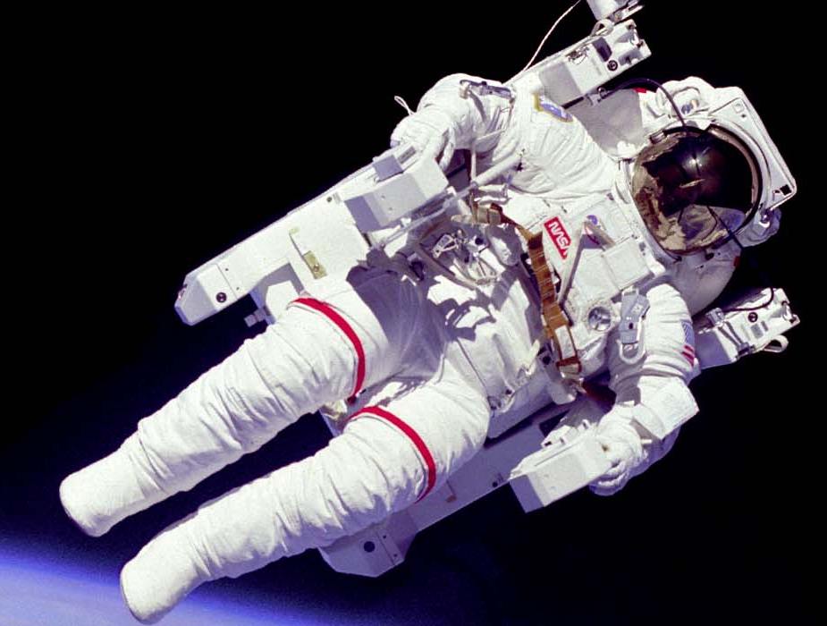
科技类话题
Science & technology
Science & technology
科技类话题词汇
2. 科技类真题思路分析
科技类话题范文分析
科技类话题提纲练习

Slide 43
词汇扩展
科技类话题
高科技
科技的进步
advanced technology
Sophisticated tech
cutting-edge tech
high-tech
the advances in tech
the technological innovations/advances

Slide 44
科技类话题
科技对教育的影响
科技对工作的影响
科技对生活的影响
multi-media devices
distance education
online class
labor-saving machinery
boost/enhance working efficiency
telecommuting
Electronic-commerce
private cars/automobiles
the Internet/ skype/ blog/ twitter
online shopping

Slide 45
科技类话题
人际关系变化
科技成就
人工智能
keep/hold/stand aloof from sb.
be indifferent to sb.
sb. is isolated/alienated
national security
scientific achievement
scientific instrument
artificial intelligence
space exploration
mechanical labor
mechanical translation
household appliance

Slide 46
科技类话题
Nowadays the way many people interact with each other has changed because of technology. In what ways has technology affected the types of relationships that people make? Has this been a positive or negative development? （C8Test2 Task2+Simon 范文）

Slide 47
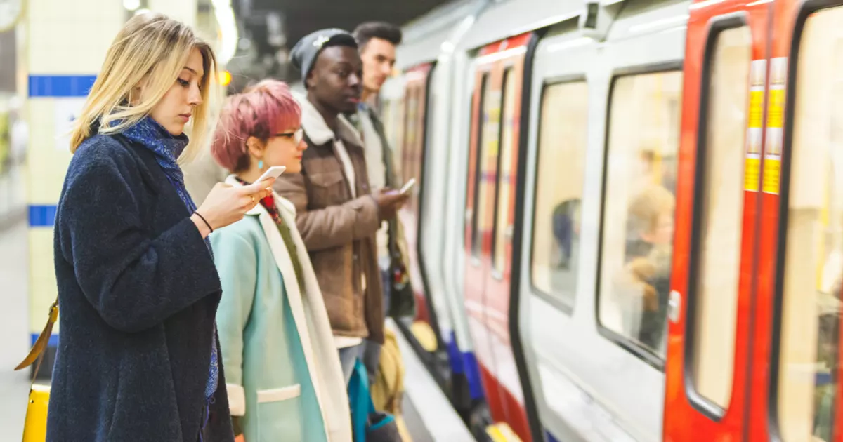
个人角度
科技类话题
提高工作效率 improve working efficiency (time-conserving)
给人们生活带来便利 bring convenience to people’s life(commuting)
方便沟通交流 facilitate communication (transcend geographical barrier)
娱乐，丰富生活 entertainment/recreation, enrich people’s life
面对面交流变少 lack face to face communication
侵犯隐私 infringe people’s privacy
辐射 intense radiation (failing eyesight, health hazard)
缺乏运动 lack exercise (obesity)

Slide 48
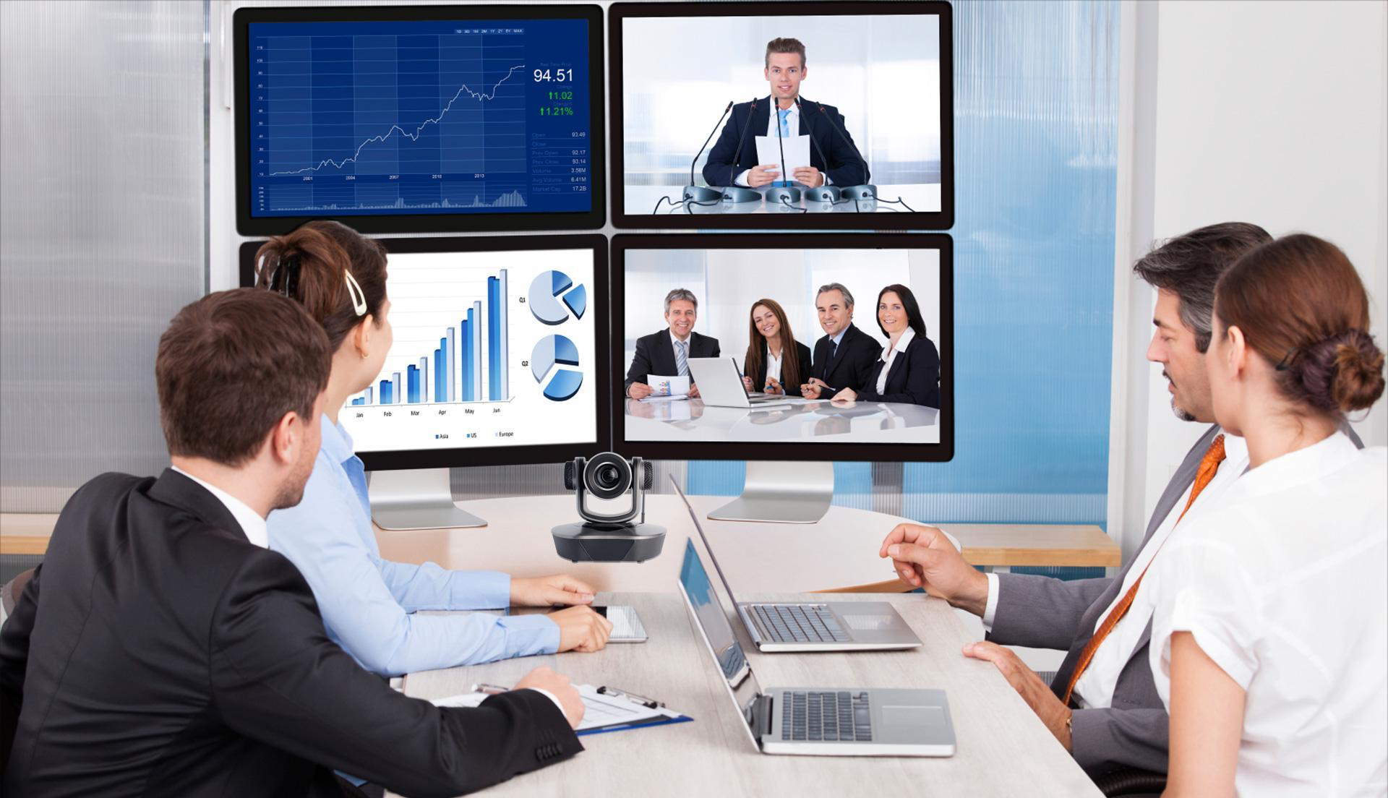
公司角度
科技类话题
减少人事成本 reduce the cost, including the budget in personnel
解放工人，增加员工满意度 save the labor/liberate workers
提高工作效率 will increase the efficiency and productivity of work, especially for the dangerous, accurate and repetitive task
过度依赖科技the overuse of high-tech
→人事关系冷漠培养 employees would become increasingly indifferent to colleagues
→不利于生产效率以及员工忠诚度的培养 having a negative effect on the production efficiency and the cultivation of loyalty to the company among workers

Slide 49

社会角度
科技类话题
促进经济发展 promote/boost economic development
提高人们生活水平 improve people’s living standard
增加就业机会 provide opportunities of employment
信息传播 (have access to) all kinds of information, ranging from A to B
环境问题 place a heavy burden on environment
社会竞争激烈 fierce/keen competition
不良信息的传播 be flooded with negative information (pornography and violence)
安全问题(网络犯罪) security (cyber crime)

Slide 50
科技类话题
Nowadays the way many people interact with each other has changed because of technology. In what ways has technology affected the types of relationships that people make? Has this been a positive or negative development? （C8Test2 Task2+Simon 范文）
首段：
It is true that new technologies have had an influence on communication between people. Technology has affected relationships in various ways, and in my opinion, there are both positive and negative effects.

Slide 51
科技类话题
Nowadays the way many people interact with each other has changed because of technology. In what ways has technology affected the types of relationships that people make? Has this been a positive or negative development? （C8Test2 Task2+Simon 范文）
主体段1：
Technology has had an impact on relationships in business, education and social life. Firstly, telephones and the Internet allow businesspeople in different countries to interact without ever meeting each other. Secondly, services like Skype create new possibilities for relationships between students and teachers. For example, a student can now take video lessons with a teacher in a different city or country. Finally, many people use social networks, like Facebook, to make new friends and find people who share common interests, and they interact through their computers rather than face to face.

Slide 52
科技类话题
Nowadays the way many people interact with each other has changed because of technology. In what ways has technology affected the types of relationships that people make? Has this been a positive or negative development? （C8Test2 Task2+Simon 范文）
主体段2：
On the one hand, these developments can be extremely positive. Cooperation between people in different countries was much more difficult when communication was limited to written letters or telegrams. Nowadays, interactions by email, phone or video are almost as good as face-to-face meetings, and many of us benefit from these interactions, either in work or social contexts. On the other hand, the availability of new communication technologies can also have the result of isolating people and discouraging real interaction. For example, many young people choose to make friends online rather than mixing with their peers in the real world, and these ‘virtual’ relationships are a poor substitute for real friendships.

Slide 53
科技类话题
Nowadays the way many people interact with each other has changed because of technology. In what ways has technology affected the types of relationships that people make? Has this been a positive or negative development? （C8Test2 Task2+Simon 范文）
结尾：
In conclusion, technology has certainly revolutionised communication between people, but not all of the outcomes of this revolution have been positive.

Slide 54
Homework（完成主体段写作）
科技类话题
Scientists believe computers will become more intelligent than human beings. Some people think the development has a positive impact; others think it is negative. To what extent do you agree or disagree? （20130829）

Slide 55
Homework（完成主体段写作）
科技类话题
For references：
Positive sides a. 电脑比人智能可以完成危险的或繁复的任务。 关键词句推荐： artificial intelligence can perform dangerous or repetitive tasks for human beings/explore distant planets/assembly line
b. 电脑比人智能可以促进研究的发展。 关键词句推荐：when computers outsmart humans, many researches that were once hindered by limited computing skills will make breakthrough

Slide 56
Homework（完成主体段写作）
科技类话题
For references：
Negative sides a. 电脑智能能可以代替人力，很多人可能因此失业unemployment rate
第一因为雇员可能还不具备操作机器需要的新技能. As it may take decades for workers to acquire the expertise needed for computer operation, those whose skills no longer match the needs of employers will lose their jobs.
第二因为电脑智能提高了生产力，不需要那么多员工了Moreover, once the productivity is raised thanks to computer technology, business can do the same work with fewer employees

Slide 57
Homework（完成主体段写作）
科技类话题
For references：
Negative sides b. 人们过度依赖电脑，如果电脑瘫痪可能造成巨大损失。 As computers approaches the intelligence of humankind, people tend to rely on this technology excessively.
A computer crash may cause huge loss including the loss of property and even life.

Slide 58
媒体广告类话题
Homework（完成主体段写作）
Nowadays a large amount of advertising aimed at children should be banned because of its negative effects. To what extent do you agree or disagree?20160220（9分达人3）

Slide 59
媒体广告类话题
Nowadays a large amount of advertising aimed at children should be banned because of its negative effects. To what extent do you agree or disagree?20160220（9分达人3）
首段：
Advertisements aimed at children can be seen everywhere these days: TV, the Internet, newspapers and magazines, to name only a few. Many people believe they should be banned because of their negative influence on children. While these advertisements do have some benefits, they are informative at least, I am quite convinced that they are more harmful than beneficial to children.

Slide 60
媒体广告类话题
Nowadays a large amount of advertising aimed at children should be banned because of its negative effects. To what extent do you agree or disagree?20160220（9分达人3）
主体段1：
In the first place, in order to attract children, many advertisers tend to over emphasize the “fun side‘ of their products. More often than not they will promote such products as computer games, dolls, animal parks and so on. I admit these products may be important to children, yet too much of them would distract children from their study. Even when they are advertising learning-aid products, the advertisers often claim their products will make children’s learning process full of fun. This is really bad because it gives children a false impression that they do not have to put serious efforts into their study. In addition, children advertising is not desirable because it often leads children to buy things that they do not really need. That is why many parents complain that their children do not buy anything but those expensive famous brands’ such as Adidas. Nike and similar brands of mass consumption.

Slide 61
媒体广告类话题
Nowadays a large amount of advertising aimed at children should be banned because of its negative effects. To what extent do you agree or disagree?20160220（9分达人3）
主体段2：
At the same time, children advertising is partly responsible for children being kept away from reality. Catering to the psychological needs of children, many advertisements describe the world in highly imaginative and unrealistic manners. For instance, when they want to promote their doll weapons, they will describe the world as a place full of bad guys. A child exposed to such advertising may develop a deep sense of hostility to the world. On the other hand, when they want to sell entertainment park tickets to children, they will describe the world as a place full of love and without any danger at all. A child who has been made to believe this kind of advertising will have a hard time when he/she comes across troubles in real life.

Slide 62
媒体广告类话题
Nowadays a large amount of advertising aimed at children should be banned because of its negative effects. To what extent do you agree or disagree?20160220（9分达人3）
结尾：
To conclude, since most children advertisements are misleading, they are really harmful to children who are not old enough to tell the difference between imagination and reality. Indeed, these advertisements may provide useful information for children, but information.

Slide 63
环境类话题
Homework（完成主体段写作）
Nowadays we are producing more and more rubbish. Why do you think this is happening? What can governments do to help reduce the amount of rubbish produced?（C5p173 General Training B ）

Slide 64
环境类话题
Nowadays we are producing more and more rubbish. Why do you think this is happening? What can governments do to help reduce the amount of rubbish produced?（C5p173 General Training B ）
首段
I think it is true that in almost every country today each household and family produces a large amount of waste every week. Most of this rubbish comes from the packaging from the things we buy, such as processed food. But even if we buy fresh food without packaging, we still produce rubbish from the plastic bags used everywhere to carry shopping home.

Slide 65
环境类话题
Nowadays we are producing more and more rubbish. Why do you think this is happening? What can governments do to help reduce the amount of rubbish produced?（C5p173 General Training B ）
主体段2
The reason why we have so much packaging is that we consume so much more on a daily basis than families did in the past. Convenience is also very important in modern life, so we buy packaged or canned food that can be transported from long distances and stored until we need it, first in the supermarket, and then at home.

Slide 66
环境类话题
Nowadays we are producing more and more rubbish. Why do you think this is happening? What can governments do to help reduce the amount of rubbish produced?（C5p173 General Training B ）
主体段2：
However, I think the amount of waste produced is also a result of our tendency to use something once and throw it away. We forget that even the cheapest plastic bag has used up valuable resources and energy to produce. We also forget that it is a source of pollution and difficult to dispose of.

Slide 67
环境类话题
Nowadays we are producing more and more rubbish. Why do you think this is happening? What can governments do to help reduce the amount of rubbish produced?（C5p173 General Training B ）
主体段3：
I think that governments need to raise this awareness in the general public. Children can be educated about environmental issues at school, but adults need to take action. Governments can encourage such action by putting taxes on packaging, such as plastic bags, by providing recycling services and by fining households and shops that do not attempt to recycle their waste

Slide 68
环境类话题
Nowadays we are producing more and more rubbish. Why do you think this is happening? What can governments do to help reduce the amount of rubbish produced?（C5p173 General Training B ）
结尾：
With the political will, such measures could really reduce the amount of rubbish we produce. Certainly, nobody wants to see our resources used up and our planet poisoned by waste.

